Slide 1

Week 4: Linear Unsupervised Learning
Part 1- PCA
Dr Maha Saadeh

Slide 2
Linear Unsupervised Learning
The fundamental principles of unsupervised learning all lie in some very elementary ideas from linear algebra
This is because unsupervised learning is about effectively representing datasets with no output, i.e., only input data.
Our goal with such data is simply to effectively represent it, and this is a task that has roots in the notion of a spanning set of vectors from basic linear algebra.

Slide 3
In this lesson Part 1 …
Linear Algebra Basics
Dimensionality Reduction
Covariance Matrix
Eigenvalues and Eigenvectors
PCA

Slide 4
Why vectors and matrices?
Most common form of data organization for machine learning is a 2D array, where
vector
 | Refund | Marital Status | Taxable Income | Cheat
 | Yes | Single Married Single | 125K 100K 70K | No No No
 | No
 | No
 |  | Married | 120K | No
 | Yes
 | No | Divorced Married Divorced Single Married Single | 95K 60K 220K 85K 75K 90K | Yes No No Yes No Yes
 | No
 | Yes
 | No
 | No
 | No
rows represent observations (records, items, data points)
columns represent attributes (features, variables)
Natural to think of each sample as a vector of attributes, and whole array as a matrix
10
matrix

Slide 5
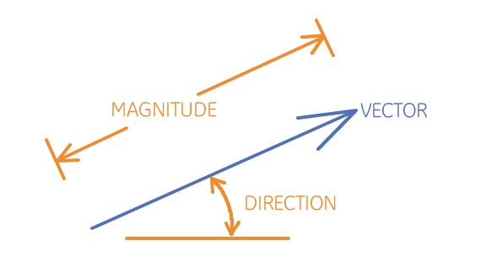
Linear Algebra Basics
Vectors
Vectors arithmetic

Slide 6
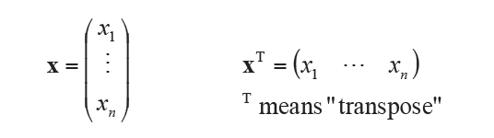
Vectors
Definition: an n-tuple of values (usually real numbers).
n referred to as the dimension of the vector
n can be any positive integer
Can be written in column form or row form
Column form is conventional
Vector elements referenced by subscript

Slide 7
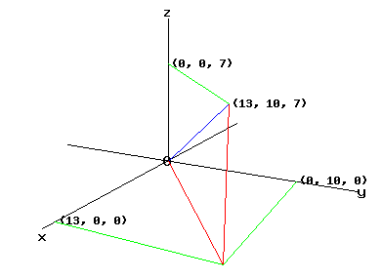
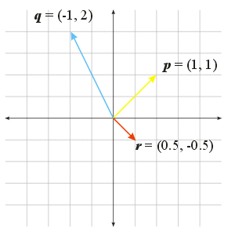
Vectors
A vector can be seen as:
A point in space, or
A directed line segment with a magnitude and direction

Slide 8
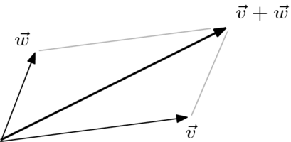
Vector arithmetic
Addition of two vectors
Let 𝒙 =
𝑥₁, … , 𝑥𝑛 ^{𝑇} and 𝒚 = 𝑦₁, … , 𝑦_{𝑛}
^{𝑇} be two
vectors in ℛ^{𝑛}, then the vector 𝒛 = 𝒙 + 𝒚 is defined as:
𝒛 = 𝑥₁ + 𝑦₁, … , 𝑥𝑛 + 𝑦𝑛
𝑇
The result is a vector in ℝ^{𝑛}.
Example: 3,2,1
𝑇 ₊
1,2,0
𝑇 ₌
4,4,1
𝑇

Slide 9
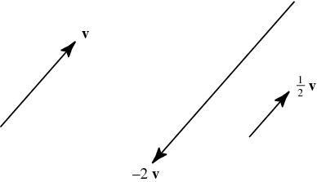
Vector arithmetic
Scalar multiplication of a vector
Let 𝒙 =
scalar.
𝑥₁, … , 𝑥𝑛 ^{𝑇} be a vector in R^{n}, let a be α
The vector 𝒚 = 𝛼𝒙 is defined as:
𝒚 = 𝛼𝑥₁, … , 𝛼𝑥_{𝑛}
𝑇
The result is a vector in ℝ^{𝑛}.
Example: 3 3,2,1
𝑇 ₌
9,6,3
𝑇

Slide 10

Vector arithmetic
Dot product of two vectors
Let 𝒙 =
𝑥₁, … , 𝑥𝑛 ^{𝑇} and 𝒚 = 𝑦₁, … , 𝑦𝑛
^{𝑇} be two vectors in
ℛ^{𝑛}, then the dot product 𝑎 = 𝒙. 𝒚 is defined as:
y
The result is a scalar.
θ
x
Example: (3,2,1)^{T} . (1,2,0)^{T} = (3 + 4 + 0) = 7

Slide 11

Vector projection
Orthogonal projection
Can take place in any space of dimensionality bigger than 2.
Projection of y onto x : drop a perpendicular line from y onto x (meet at point ) and the projection vector is the vector to that point.
y
θ
proj_{x}( y )
x
Dot product form:
$${Proj}_{x}\left(y\right)= \frac{\left(x . y\right).x}{(x.x)}$$
Example: ${Proj}_{(4,3,0)}\left((25,0,5)\right)= \frac{\left(100+0+0\right). (4,3,0)}{(16+9+0)}=(16,12,0)$

Slide 12
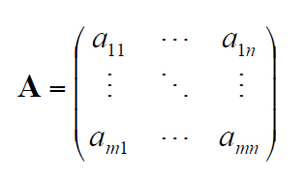
Matrices
Definition: an m x n two-dimensional array of values (usually real numbers).
m rows
n columns
Matrix referenced by two-element subscript
first element in subscript is row
second element in subscript is column
example: A_{2,4} or a_{2,4} is element in second row, fourth column of A

Slide 13
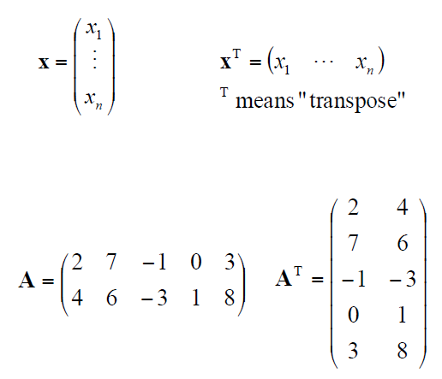
Matrices
A vector can be regarded as special case of a matrix, where one of matrix dimensions = 1.
Matrix transpose (denoted ^{T})
swap columns and rows (row 1 becomes column 1, etc.)
m x n matrix becomes n x m
matrix.

Slide 14
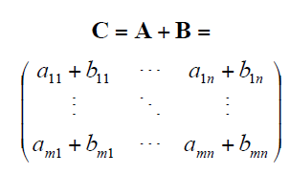
Matrix arithmetic
Addition of two matrices
Matrices must be same size
The sum 𝑪 = 𝑨 + 𝑩 is defined such as, for each
𝑖, 𝑗:
^{𝑐i},j ^{= 𝑎i},j ^{+ 𝑏i},j
The result is a matrix of same size

Slide 15
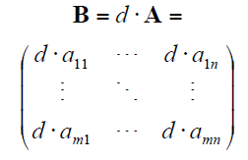
Matrix arithmetic
Scalar multiplication
The scalar multiplication of a scalar 𝑑 by a matrix 𝑨 is defined such as for each element 𝑖, 𝑗:
^{𝑏i},j ^{= 𝑑 . 𝑎i},j
The result is a matrix of same size.

Slide 16

Matrix arithmetic
Matrix multiplication
Matrix-matrix multiplication is defined as the rows by columns multiplication:
A vector-matrix multiplication just a special case of a matrix-matrix multiplication.
p
n
p
m
column
j
row i
·
n
=
cij
A
C
B

Slide 17
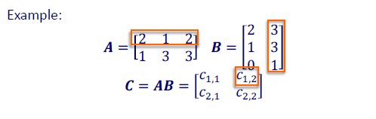
Matrix arithmetic
Matrix multiplication
C_{1,2} = 2*3 + 1*3 + 2*1 = 6 + 3 + 2 = 11

Slide 18

Matrix arithmetic
Matrix multiplication
Rule. In any chain of matrix multiplications, the column dimension of one matrix in the chain must match the row dimension of the following matrix in the chain.
Check the dimensionality...
Matrix A has (n, m) dimensions
Matrix B has (m, p) dimensions
The resulting matrix C = A x B will have (n, p) dimensions.

Slide 19
Linear transformation
Let 𝑨 be a matrix m x n (note the order of m and n switched) Let 𝒙 be a vector of n elements.
What do you get if you multiply 𝑨 by a vector 𝒙?
In other words, what does 𝑨𝒙 represent?

Slide 20
Linear transformation
As an example:
Let 𝒙 be 𝒙 =
𝑥, 𝑦, 𝑧 ^{𝑇}
1 | 0 | −1
3 | 1 | 2
Let 𝑨 be 𝑨 =
Remember matrix multiplication...
𝑥
𝑦
𝑧
0 −1
3 1 2
𝐴𝑥 = ¹
= ? ? ?

Slide 21
Linear transformation
As an example:
Let 𝒙 be 𝒙 =
𝑥, 𝑦, 𝑧 ^{𝑇}
1 | 0 | −1
3 | 1 | 2
Let 𝑨 be 𝑨 =
Remember matrix multiplication...
The result is a Vector
𝑥
𝑦
𝑧
𝐴𝑥 = ¹
0 −1
3 1 2
𝑥 − 𝑧
3𝑥 + 𝑦 + 2𝑧
=

Slide 22
Linear transformation
Given any 𝑚×𝑛 matrix 𝑨, we can define a function
𝑇: ℝ^{𝑛} → ℝ^{𝑚}
𝑇 𝒙 = 𝑨𝒙
where 𝒙 is an n-dimensional vector in ℝ^{𝑛}.

Slide 23

Linear transformation
Given any 𝑚×𝑛 matrix 𝑨, we can define a function
𝑇: ℝ^{𝑛} → ℝ^{𝑚}
𝑇 𝒙 = 𝑨𝒙
where 𝒙 is an n-dimensional vector in ℝ^{𝑛}.
Square matrices are important... Why?

Slide 24
Linear transformation
Given any 𝑚×𝑛 matrix 𝑨, we can define a function
𝑇: ℝ^{𝑛} → ℝ^{𝑚}
𝑇 𝒙 = 𝑨𝒙
where 𝒙 is an n-dimensional vector in ℝ^{𝑛}.
Square matrices are important... Why?
Because they define linear transformation 𝑇: ℝ^{𝑛} → ℝ^{𝑛}.
That is, the original and transformed space have the same dimensionality.
If we restrict ourselves to mappings within the same space, such as
𝑇: ℝ^{𝑛} → ℝ^{𝑛}
then 𝑇 is associated with a
square 𝑛×𝑛 matrix.

Slide 25
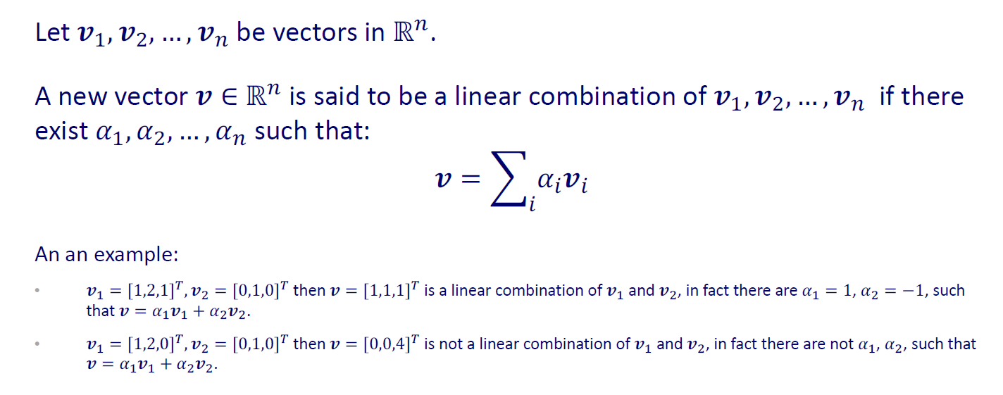

Linear Combination
$$\vec{v}= \vec{v1}− \vec{v2}$$

Slide 26
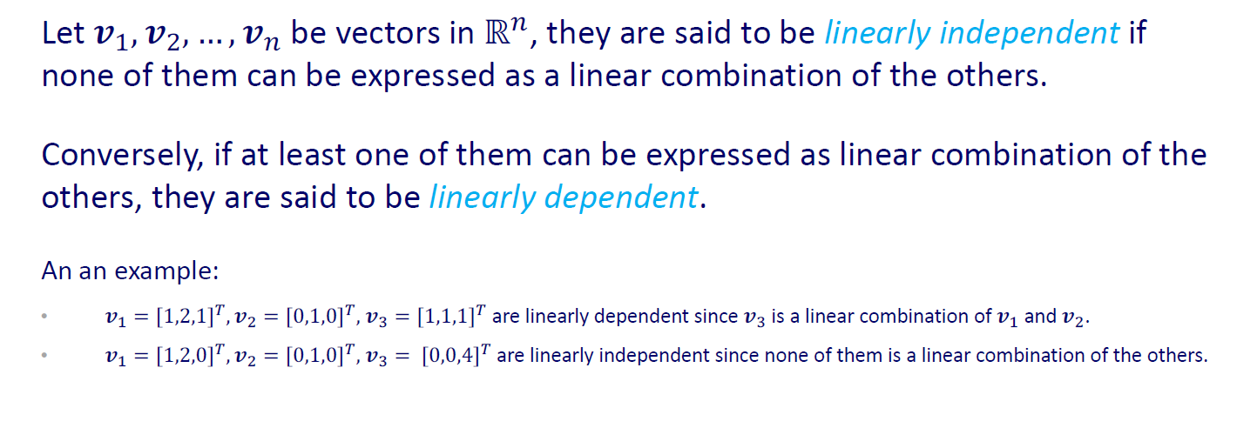

Vectors Linearly Independent
$$\vec{v3}= \vec{v1}− \vec{v2}$$

Slide 27
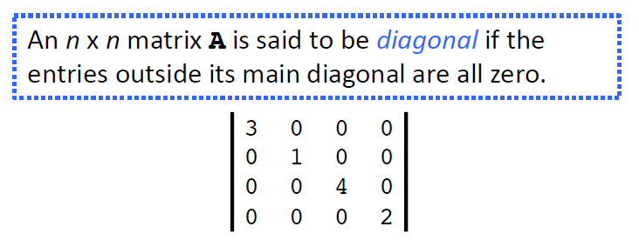
Diagonal Matrix

Slide 28
In this lesson Part 1 …
Linear Algebra Basics
Dimensionality Reduction
Covariance Matrix
Eigenvalues and Eigenvectors
PCA

Slide 29
Dimensionality reduction
Goal:
Reduce high dimensional data in lower components.
The reduced components need to be independent
Processing high dimensional data is computationally expensive
The trick in dimensionality reduction is to trade a little accuracy for simplicity.
Smaller data sets are easier to explore
and visualize
and make analyzing data much easier and faster for machine learning algorithms

Slide 30
Dimensionality reduction
The intuition behind it

Slide 31
Consider the following example
Original 2D data
X-Projection
Y-Projection

Slide 32
Consider the following example
Original 2D data
X-Projection
Y-Projection

Slide 33
Consider the following example
Original 2D data
X-Projection
Y-Projection

Slide 34
Consider the following example
Original 2D data
X-Projection
Y-Projection
Which projection is more representative of the original data?

Slide 35
Consider the following example
Original 3D data
X-Z Projection
Y-Z Projection
X-Y Projection

Slide 36


Consider the following example
X-Z Projection
X-Y Projection
Original 3D data
Y-Z Projection

Slide 37
Consider the following example
X-Z Projection
X-Y Projection
Original 3D data
Y-Z Projection

Slide 38
Consider the following example
X-Z Projection
X-Y Projection
Original 3D data
Y-Z Projection

Slide 39
Consider the following example
X-Z Projection
X-Y Projection
Original 3D data
Y-Z Projection
Which projection is more representative of the original data?

Slide 40
Notes
We need to keep data with large variance (more information)

Slide 41
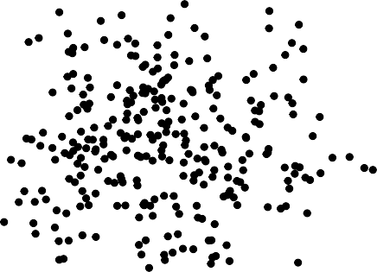
Dimensionality reduction
What do we mean for dimensionality reduction?
Imagine to have the data of the right plot over the two variables, v₁ and v₂.
Imagine we want to reduce our problem so to use only one variable.
Data of the right plot has high entropy (high disorder) and it cannot be compressed into a lower dimensionality space without losing information.
2
v2
0
−2
−3
−2
−1
0
v1
1
2

Slide 42
Dimensionality reduction
What do we mean for dimensionality reduction?
Imagine to have the data of the right plot over the two variables, v₁ and v₂.
Imagine we want to reduce our problem so to use only one variable.
Data of the right plot has high entropy (high disorder) and it cannot be compressed into a lower dimensionality space without losing information.
2
v2
0
−2
−3
−2
−1
0
v1
1
2

Slide 43
Dimensionality reduction
What do we mean for dimensionality reduction?
Imagine to have the data of the right plot over the two variables, v₁ and v₂.
Imagine we want to reduce our problem so to use only one variable.
Data of the right plot has high entropy (high disorder) and it cannot be compressed into a lower dimensionality space without losing information.
2
v2
0
v1

Slide 44
Dimensionality reduction
What do we mean for dimensionality reduction?
Imagine to have the data of the right plot over the two variables, v₁ and v₂.
Imagine we want to reduce our problem so to use only one variable.
Data of the right plot has high entropy (high disorder) and it cannot be compressed into a lower dimensionality space without losing information.
2
v2
0
−2
−3
−2
−1
0
v1
1
2

Slide 45
Notes
We need to keep as much data as possible (more information)
When we have high disorder data, dropping one dimension will cause information lost.

Slide 46
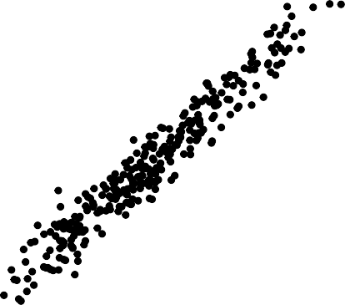
Dimensionality reduction
Let's consider now the data of the right plot.
What's difference between this data and the one visualised before?
This data has more order.
3
2
1
v2
0
−1
−2
−3
−2
−1
0
v1
1
2

Slide 47
Dimensionality reduction
Let's consider now the data of the right plot.
What's difference between this data and the one visualised before?
This data has more order.
3
x₂
x
1
2
1
v2
0
−1
- The new axes x₁, x₂ can be chosen over
v₁, v₂.
−2
−3
−2
−1
0
v1
1
2

Slide 48
Dimensionality reduction
Let's consider now the data of the right plot.
What's difference between this data and the one visualised before?
This data has more order.
3
x
1
2
1
v2
0
−1
The new axes x₁, x₂ can be chosen over
v₁, v₂.
Under this reference, the axis x₂ can be removed as it is not so informative.
−2
−3
−2
−1
0
v1
1
2
This is the intuitive explanation of dimensionality reduction.

Slide 49
Notes
We need to keep as much data as possible (more information)
When we have high disorder data, dropping one dimension will cause information lost.
When we have more ordered data, the direction can help here to reduce the dimension.
and remember, we need to keep as much data as possible (variance) Covariance matrix can be helpful here

Slide 50
In this lesson Part 1 …
Linear Algebra Basics
Dimensionality Reduction
Covariance Matrix
Eigenvalues and Eigenvectors
PCA

Slide 51
Covariance matrix and dimensionality reduction
Let's say you want to reduce the dimensionality of your data set, say down to just one dimension.
In general, this means picking a unit vector u, and replacing each data point, xi, with its projection along this vector, u^{T}xi.
Of course, you should choose u so that you retain as much of the variation of the data points as possible.
if your data points lay along a line and you picked u orthogonal to that line, all the data points would project onto the same value, and you would lose almost all the information in the data set!
So you would like to maximize the variance of the new data values u^{T}xi.
So the unit vector that we are looking for is the vector in the direction of the axes where there is the most variance (most information),

Slide 52
Covariance matrix and dimensionality reduction
The relationship between variance and information here, is that, the larger the variance carried by a line, the larger the dispersion of the data points along it, and the larger the dispersion along a line, the more the information it has.
Covariance matrix can tell us this information

Slide 53
Covariance Matrix
Used to understand how the variables of the input dataset are varying from the mean with respect to each other, or in other words, to see if there is any relationship between them.
So, in order to identify these correlations, we compute the covariance matrix.

Slide 54



Covariance Matrix
Variance measures the variation of a single random variable (like the height of a person in a population).
Covariance is a measure of how much two random variables vary together (like the height of a person and the weight of a person in a population).
Average squared DISTANCE
from
∑(𝑥𝑖 − 𝑥𝜇)
2
$$σ_{x,x}=$$
𝑛
the mean
$$σ_{x,y}=$$
∑(𝑥𝑖 − 𝑥𝜇)
(y𝑖 − y𝜇)
𝑛

Slide 55

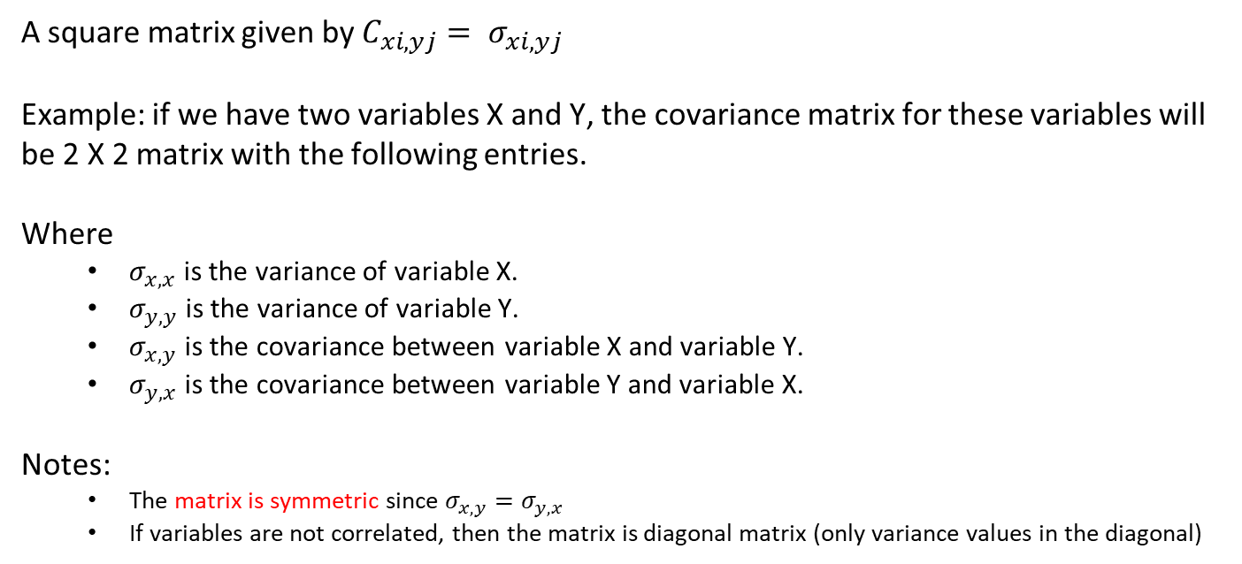
Covariance Matrix
A square matrix given by $C_{xi,yj}= σ_{xi,yj}$
Example: if we have two variables X and Y, the covariance matrix for these variables will be 2 X 2 matrix with the following entries.
Where
$σ_{x,x}$ is the variance of variable X.
$σ_{y,y}$ is the variance of variable Y.
$σ_{x,y}$ is the covariance between variable X and variable Y.
$σ_{y,x}$ is the covariance between variable Y and variable X.
Notes:
The matrix is symmetric since $σ_{x,y}=σ_{y,x}$
If variables are not correlated, then the matrix is diagonal matrix (only variance values in the diagonal)
$$\left[\begin{matrix}σ_{x,x} & σ_{x,y} \\ σ_{y,x} & σ_{y,y}\end{matrix}\right]$$

Slide 56
In this lesson Part 1 …
Linear Algebra Basics
Dimensionality Reduction
Covariance Matrix
Eigenvalues and Eigenvectors
PCA

Slide 57
Eigenvalues and Eigenvectors
Suppose we have plotted a scatter plot of random variables, and a line of best fit is drawn between these points. This line of best fit, shows the direction of maximum variance in the dataset.
The Eigenvector is the direction of that line, while the eigenvalue is a number that tells us how the data set is spread out on the line which is an Eigenvector.
Eigenvectors represent directions. Eigenvalues represent magnitude, or importance.
V2
V1

Slide 58
Eigenvalues and Eigenvectors
Some properties:
Matrix A can be decomposed into a number of eigenvectors and eigenvalues.
Eigenvectors and eigenvalues uniquely identify a matrix A.
This number is equal to the number of dimensions (variables) of the data.
For example, for a 3-dimensional data set, there are 3 variables, therefore there are 3 eigenvectors with 3 corresponding eigenvalues.
The direction of an eigenvector remains unchanged when a linear transformation is applied to it. So, assume that the transformation T(v) = Av will result in transforming the vector v in the same direction.

Slide 59
In this lesson Part 1 …
Linear Algebra Basics
Dimensionality Reduction
Covariance Matrix
Eigenvalues and Eigenvectors
PCA

Slide 60
Principal Component Analysis
The most fundamental unsupervised learning method is known as Principal Component Analysis or PCA for short.
Goal:
reduce the number of variables of a data set, while preserving as much information as possible.
HOW?
The objective is to learn a proper spanning set to represent input data .
A spanning set is the set of directions onto which data is projected.

Slide 61
What does Principal components mean ?
Principal components are new variables (vectors) that are constructed as linear combinations or mixtures of the initial data variables (vectors).
These combinations are done in such a way that the new variables (i.e., principal components) are uncorrelated and most of the information within the initial variables is squeezed or compressed into the first components.
So, the idea is 10-dimensional data gives you 10 principal components, but PCA tries to put maximum possible information in the first component, then maximum remaining information in the second and so on.

Slide 62
What does Principal components mean ?
To put all this simply, just think of principal components as new axes that provide the best angle (direction) to see and evaluate the data, so that the differences between the observations are better visible.

Slide 63


Slide 64
What does Principal components mean ?
The second principal component is calculated with the condition that it is uncorrelated with (i.e., perpendicular to) the first principal component and that it accounts for the next highest variance.
This continues until a total of p principal components have been calculated, equal to the original number of variables.

Slide 65
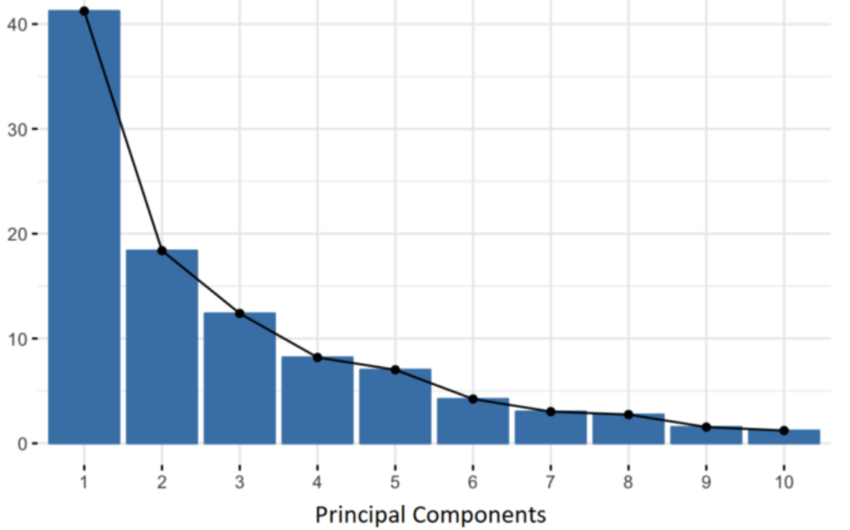
What does Principal components mean ?
Organizing information in principal components this way, will allow you to reduce dimensionality without losing much information, and this by discarding the components with low information and considering the remaining components as your new variables

Slide 66
How to calculate the principal components
It is eigenvectors and eigenvalues who are behind all the magic, because the eigenvectors of the Covariance matrix are actually the directions of the axes where there is the most variance(most information) and that we call Principal Components.
And eigenvalues are simply the coefficients attached to eigenvectors, which give the amount of variance carried in each Principal Component.
By ranking your eigenvectors in order of their eigenvalues, highest to lowest, you get the principal components in order of significance.

Slide 67
Eigenvectors and Spanning Set
The selected eigenvectors are the spanning set of the subspace onto which we project the data.

Slide 68
How to calculate the principal components
For PCA, we need:
A measure of how each variable is associated with one another. (Covariance matrix.)
The directions in which our data are dispersed. (Eigenvectors.)
The relative importance of these different directions. (Eigenvalues.)
PCA combines our predictors and allows us to drop the Eigenvectors that are relatively unimportant.

Slide 69
Python Exercise
Use the Iris data
Standardize the data (for normalization, standardize the range of the continuous initial variables so that each one of them contributes equally to the analysis)
Find the covariance matrix C
Find the eigenvalues and eigenvectors for C
Find percentage of variance (information) accounted for by each component
Decide which dimensions to select (the number of PCA components to keep)
Find the final features which = selected PCA components * scaled data .

